Slide 1
Price Ceilings, Market Structure, and Payout Policies
Xiongshi Li Guangxi University of Finance and Economics, China
Mao Ye Cornell University
Miles Zheng Texas Christian University
Presented by Austin Francis

Slide 2
Research Question
How does voluntary information sharing by private borrowers affect lender competition, borrower switching behavior, loan financing costs, and financial constraints?

Slide 3
Prior Literature
Miller and Modigliani (1961) argue that in a frictionless market, it does not matter whether firms pay out through dividends or share repurchases. It also suggests that shareholders would prefer repurchases if dividends are taxed at a higher rate than capital gains.
Surprisingly, dividends dominated share repurchases until the 1990s.
Notes:
Relationship lenders often acquire private information about borrowers, creating an information asymmetry that makes it costly for borrowers to switch lenders. This allows relationship lenders to increase loan spreads and hold up borrowers
Potential outside lenders face a winner’s curse when competing to lend to a borrower with an incumbent lender, as the outside lenders are less informed
Borrowers respond to information asymmetry by publicly sharing information, which reduces loan spreads by increasing lender competition

Slide 4
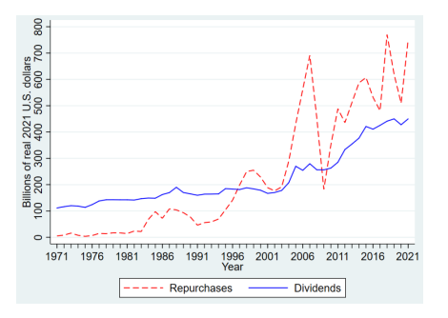
Prior Literature
Notes:
Relationship lenders often acquire private information about borrowers, creating an information asymmetry that makes it costly for borrowers to switch lenders. This allows relationship lenders to increase loan spreads and hold up borrowers
Potential outside lenders face a winner’s curse when competing to lend to a borrower with an incumbent lender, as the outside lenders are less informed
Borrowers respond to information asymmetry by publicly sharing information, which reduces loan spreads by increasing lender competition

Slide 5
Prior Literature
Market structure reforms have been reducing friction that constrain issuers from buying at the price ceilings.
Notes:
Relationship lenders often acquire private information about borrowers, creating an information asymmetry that makes it costly for borrowers to switch lenders. This allows relationship lenders to increase loan spreads and hold up borrowers
Potential outside lenders face a winner’s curse when competing to lend to a borrower with an incumbent lender, as the outside lenders are less informed
Borrowers respond to information asymmetry by publicly sharing information, which reduces loan spreads by increasing lender competition

Slide 6
Institutional Background
Price Ceilings enacted under SEC Rule 10b-18
Evolving markets developed algorithms and dark pools to reduce costs and risk associated with share repurchases
Notes:
The SEC introduced Rule 10b-18 in 1982 to provide a safe harbor for companies repurchasing their own shares, protecting them from charges of market manipulation. SEC Rule 10b-18 was introduced to create a “safe harbor” for companies repurchasing their own shares, protecting them from charges of market manipulation under the Securities Exchange Act of 1934. However, to benefit from this protection, firms must follow four key conditions:
Manner: Firms can only use one broker or dealer to execute repurchases in a single day.
Timing: Firms cannot repurchase shares during the opening or final 30 minutes of trading.
Price: The repurchase price cannot exceed the highest independent bid or the last independent trade price.
Volume: Firms cannot repurchase more than 25% of the average daily trading volume over the previous four weeks.

Slide 7
Key Findings
When trading becomes more complex or expensive, firms reduce their share buyback significantly.
Market-structure reforms have played a key role in boosting share repurchase.

Slide 8
Experiment Details
Tick Size Pilot Program: SEC experiment to from 2016 to 2018. It tested how changing the tick size for stocks from $0.01 to $0.05 impacted trading behaviors. This was a partial reversal of preview reforms.

Slide 9
Experiment Details
Control Group: 1,199 firms continued to be traded at the 1 cent tick size

Slide 10
Experiment Details
Treatment Group: 1200 firms were divided into three groups.
Group 1: quoted in 5 cent increments, but traded in 1 cent increments
Group 2: quoted and traded in 5 cent increments
Group 3: same as group 2, but subject to an additional Trade-at-Rule, requiring a price improvement to execute hidden orders

Slide 11
Experiment Details
Key Variables :
Repurchase payouts
Dividend payouts
Total payouts

Slide 12
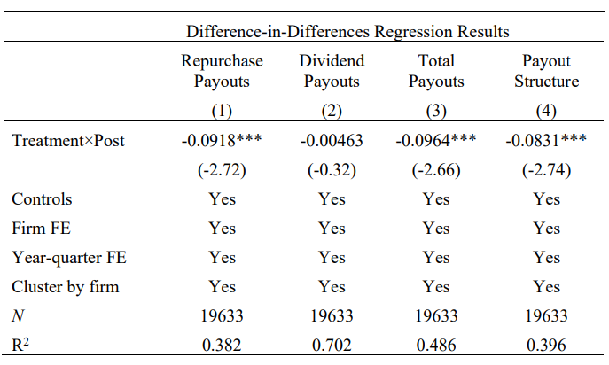
Table 1 – Difference-in-Differences Results

Slide 13
Table 1 Takeaways
Repurchase payouts dropped by .09 percentage points. Firms are repurchasing fewer shares due to the pilot
Dividend payouts remain unchanged
Total payouts decreased

Slide 14
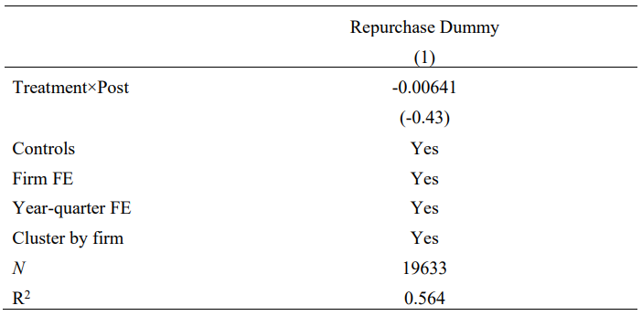
Table 2 -Extensive vs Intensive Margins

Slide 15
Table 2 Takeaways
The extensive margin, which measures how many firms repurchase shares, does not show significant changes
The decrease in share repurchases comes from treatment firms buying back fewer shares after the Pilot.
Notes:
meaning the number of companies repurchasing shares stayed roughly the same.

Slide 16
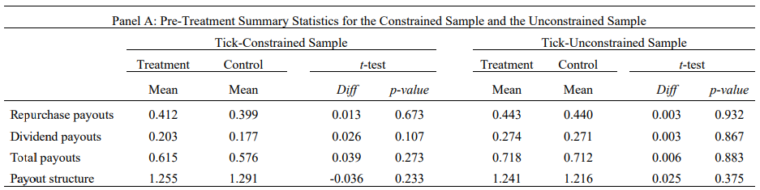
Table 3 - The Queuing Channel
Notes:
Tick-Constrained Firms:
These firms had pre-Pilot quoted spreads (the difference between bid and ask prices) that were less than 5 cents.
The Tick Size Pilot imposed a binding constraint on these firms by increasing the tick size to 5 cents, meaning these firms faced tighter trading conditions and greater price competition at the new, wider tick size.
Results showed that tick-constrained firms experienced a larger reduction in share repurchases, around 45%, because the wider tick size increased queuing competition (more traders quoting the same price), making it harder for firms to repurchase shares at the price ceiling.
Tick-Unconstrained Firms:
These firms had pre-Pilot quoted spreads greater than 5 cents, so the new 5-cent tick size did not impose as significant a constraint on them.
Since their trading conditions were already broader, they did not face the same level of increased competition at the new tick size.
Tick-unconstrained firms showed little to no reduction in share repurchases, indicating that the Pilot's effects were mainly felt by firms that were constrained by the new tick size rules.
In summary, tick-constrained firms were more heavily impacted by the tick size increase, which led to a significant drop in their ability to buy back shares, while tick-unconstrained firms were relatively unaffected.

Slide 17
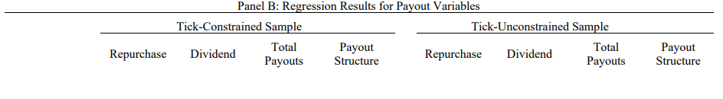
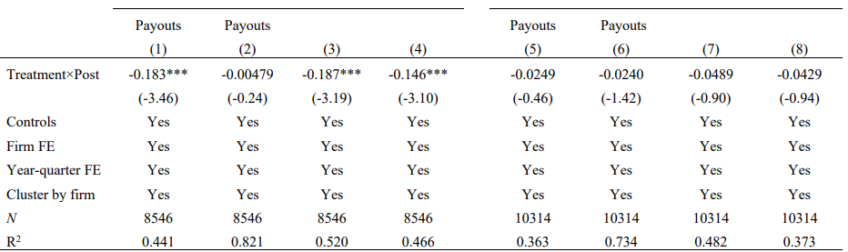
Table 3 - The Queuing Channel
Notes:
Model 3: controls for cash and leverage effects over time.

Slide 18
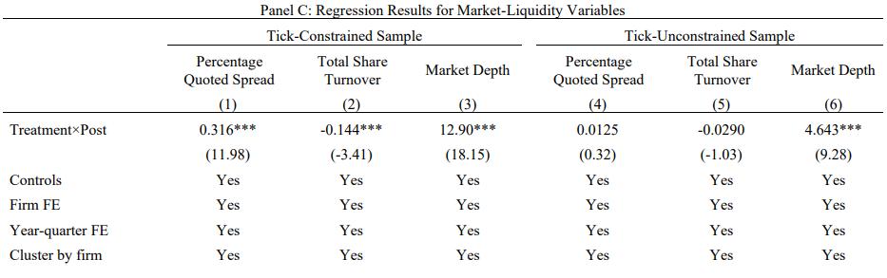
Table 3 - The Queuing Channel
Notes:
Model 3: controls for cash and leverage effects over time.

Slide 19
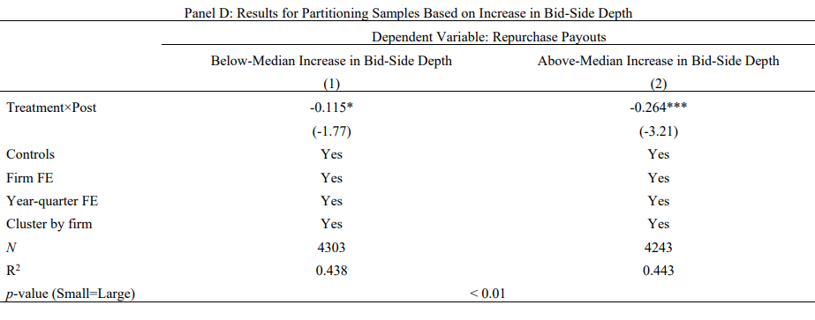
Table 3 - The Queuing Channel
Notes:
Model 3: controls for cash and leverage effects over time.

Slide 20
Table 3 Takeaways
Tick constrained firms saw a decrease in repurchase payouts. 0.183 percentage points difference (45% change from 0.41)
Firms in tick-unconstrained conditions did not show significant reductions, meaning the Pilot mainly impacted firms already facing tight trading constraints

Slide 21
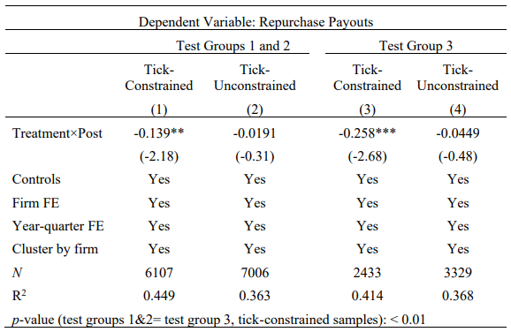
Table 4 - Dark Pool Channel

Slide 22
Table 4 Takeaways
Test group 3 (with stricter trading rules) saw a significant reduction in repurchases
Test groups 1+2 saw a smaller reduction in repurchases
The difference suggests dark pools play a crucial role in allowing firms to repurchase shares effectively, with test group 3 suffering the most

Slide 23
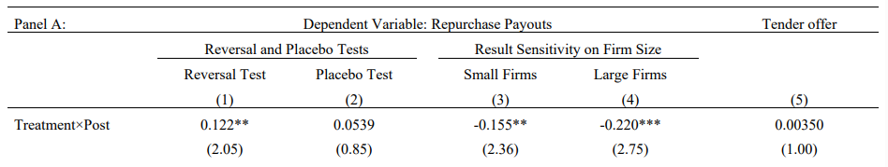
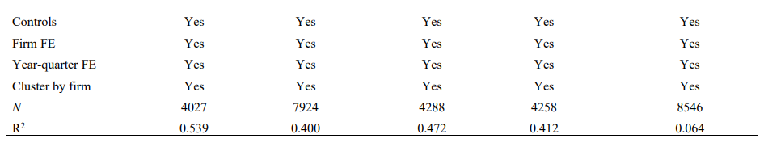
Table 5 – Robustness Checks

Slide 24
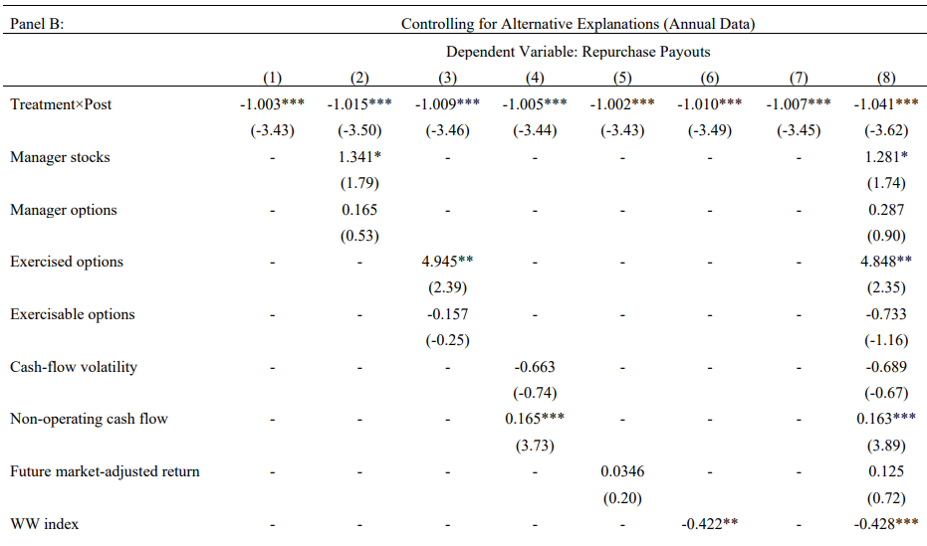
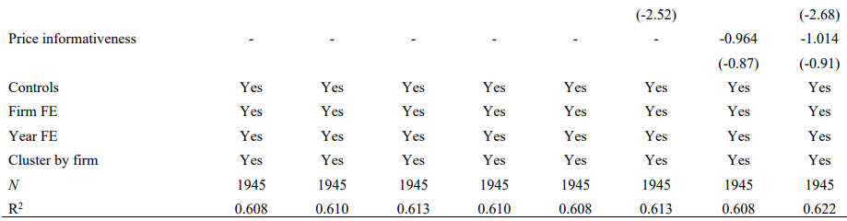
Table 5 – Panel B: Controlling for Alternative Explanations

Slide 25
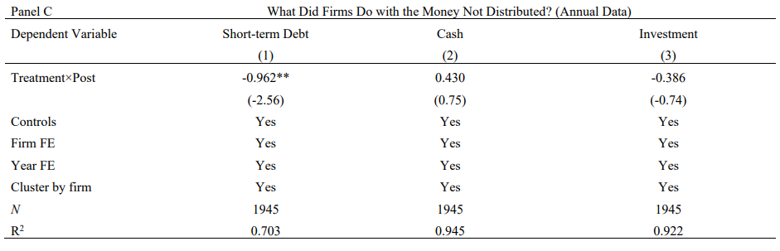
Table 5 – Panel C

Slide 26
Table 5 Takeaways
The reversal test shows that firms return to their normal repurchase behavior after the Pilot ends
Short-term debt reduction is observed in treating firms, suggesting undistributed cash is used to reduce debt

Slide 27
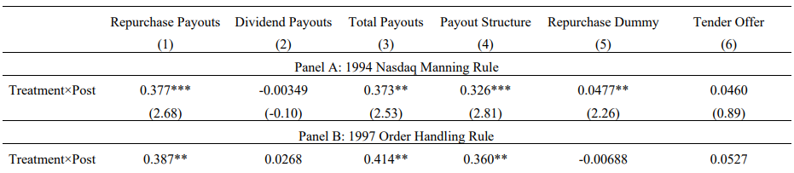
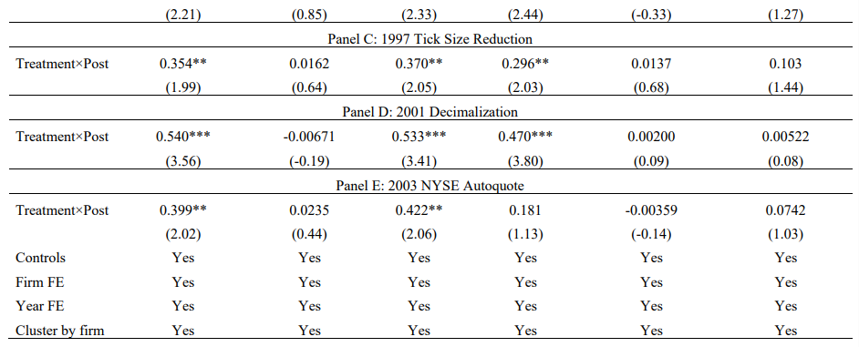
Table 6 – Event Studies
Notes:
1994 Nasdaq Manning Rule:
Prevented dealers from trading ahead of customers, leading to a 60% increase in repurchases for Nasdaq firms.
1997 Order Handling Rules:
Made firm limit orders visible to all dealers, increasing transparency and improving firms' execution priority. This resulted in a 38% increase in repurchases for Nasdaq firms.
1997 Tick Size Reduction:
Reduced tick sizes (price increments) from $1/8 to $1/16, lowering transaction costs and increasing repurchases by 41%.
2001 Decimalization:
Reduced tick sizes further to $0.01, making trading cheaper and increasing repurchases by 32%.
2003 NYSE Autoquote Installation:
Automating order execution reduced costs and compliance friction, boosting repurchases by 25%.

Slide 28
Table 6 Takeaways
Different market reforms show similar results
The results suggest that market-structure changes, such as decimalization and order-handling reforms, had lasting impacts on firm’s repurchase behaviors

Slide 29
Table 7 – Event Studies
Notes:
Book leverage.

Slide 30
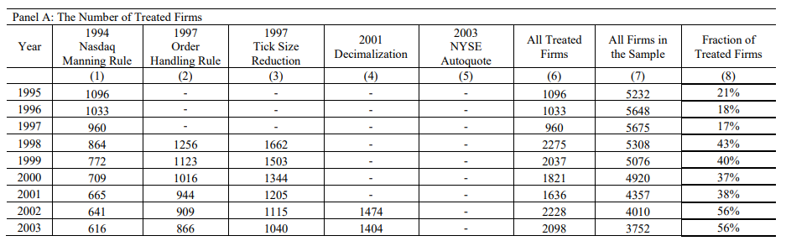
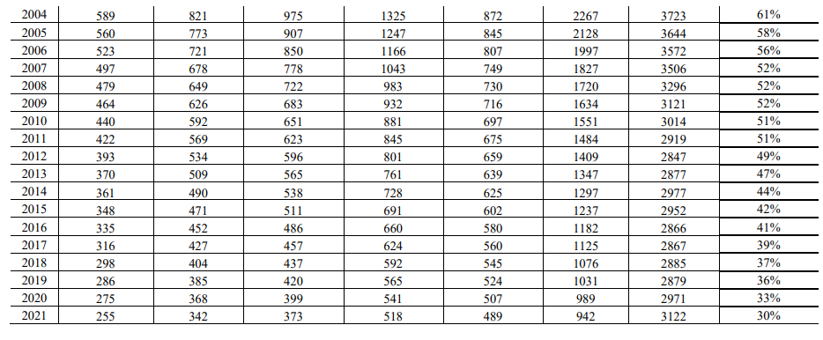

Slide 31
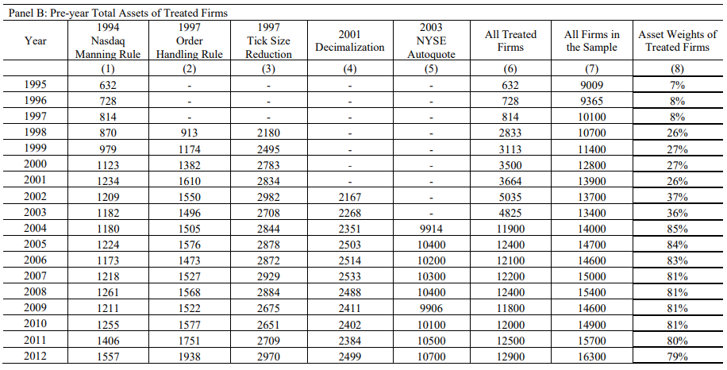
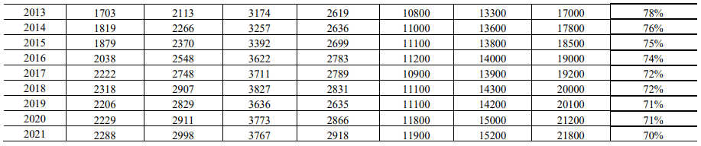

Slide 32
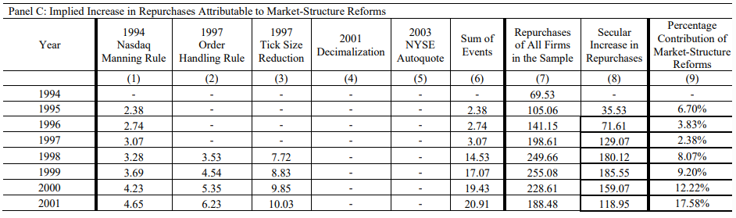
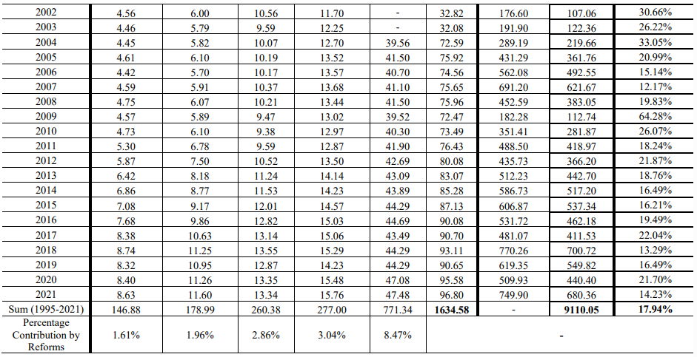

Slide 33
Table 7 Takeaways
Market Structure reforms accounted for 18% of the overall rise in share repurchases from 1995 to 2021
NYSE Autoquote installation had the largest impact

Slide 34
Conclusion
Market-structure reforms have played a key role in boosting share repurchases by reducing trading frictions and improving issuers' ability to repurchase shares at price ceilings.
Major reforms, like the Nasdaq Manning Rule and tick-size reductions, gave issuers better execution priority and relaxed price constraints, leading to a long-term increase in buybacks over dividends.
The study finds that 18% of the secular rise in share repurchases from 1995 to 2021 can be attributed to these market reforms

